Slide 1
Computer Forensic
Dr. Risala Tasin Khan
Professor
IIT, JU

Slide 2
Introduction
Computer Forensic refers to the set of methodological procedures or techniques that helps identify , gather, preserve, interpret, document and present evidence from computing equipment in such a way that any collected document is acceptable during a legal and/or administrative proceeding.
Objective:
To track and prosecute the preparators of a cyber crime
To gather evidence of a cyber crime in a forensically sound manner.
To estimate the potential impact caused by the incident on the victim and determine the intent to the perpetrator.
To minimize the tangible and intangible losses to the organization.
To protect the organization from similar incidents in the future.

Slide 3
Need for Computer Forensic
To ensure the overall integrity and continued existence of IT systems and network infrastructure within the organization
To extract, process and interpret the factual evidence in such way that it proves attacker’s action in the court.
To effectively track down perpetrators from different parts of the world.
To protect organization’s financial resource and valuable time.

Slide 4
Why we need to use Computer Forensic
Crime investigation:
It plays a crucial role in solving cybercrimes like hacking, identity theft, and online fraud by tracing digital footprints and recovering deleted or hidden data.
Legal evidence:
Courts rely on digital evidence from phones, computers, and networks. Forensics ensures this evidence is collected and presented properly.
Corporate protection:
Businesses use it to investigate data breaches, insider threats, or intellectual property theft, helping them respond quickly and prevent future incidents.
Data recovery:
It can retrieve lost or corrupted data, which is vital in both criminal cases and accidental data loss scenarios.
National security:
Governments use it to track cyberterrorism, espionage, and other threats that target critical infrastructure.

Slide 5
When to use Computer Forensic
Computer forensics is used whenever there's a need to uncover, preserve, and analyze digital evidence—especially in situations where data integrity, security, or legality is at stake. Here are some key scenarios
When a breach of contract occurs.
When copyright and intellectual property theft/misuse occurs.
In case of employee disrupt or disgruntled employee.
In case of damage to the resources.

Slide 6
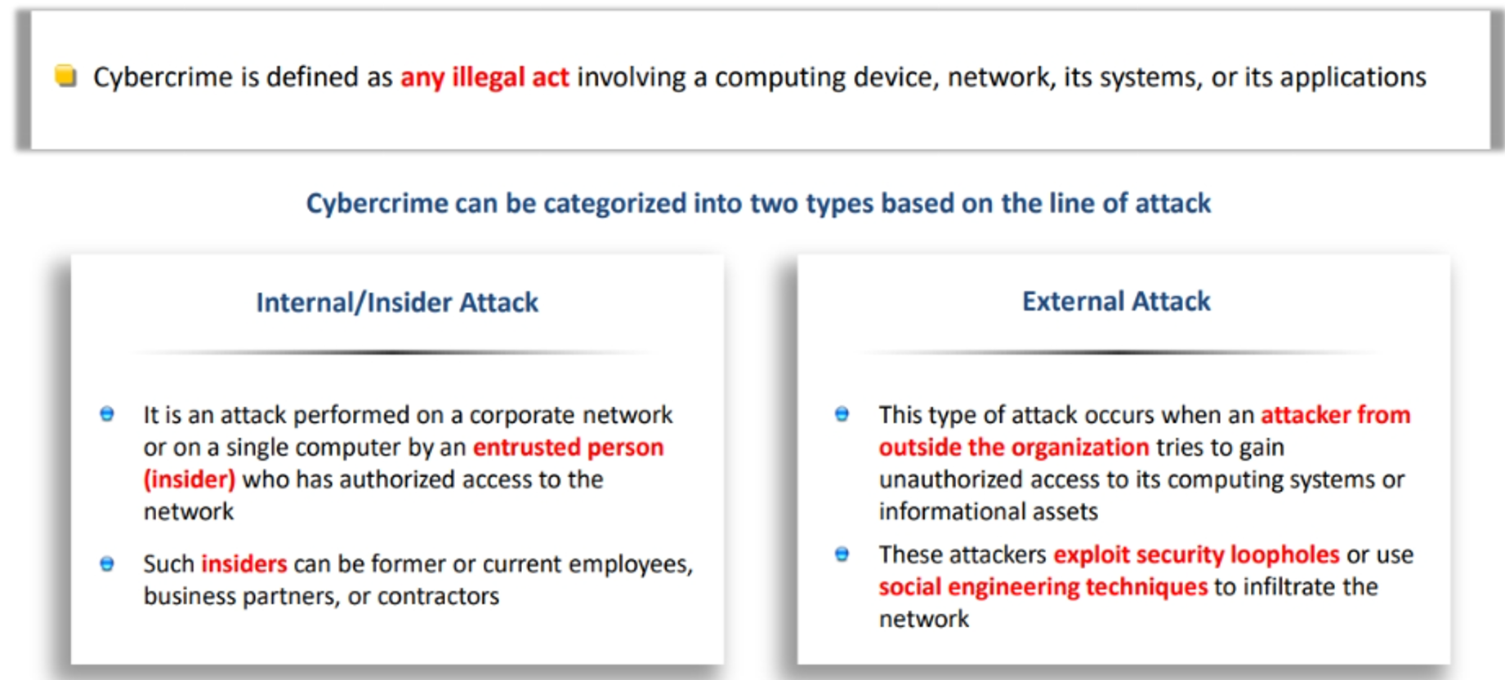
Types of Cyber Crime

Slide 7
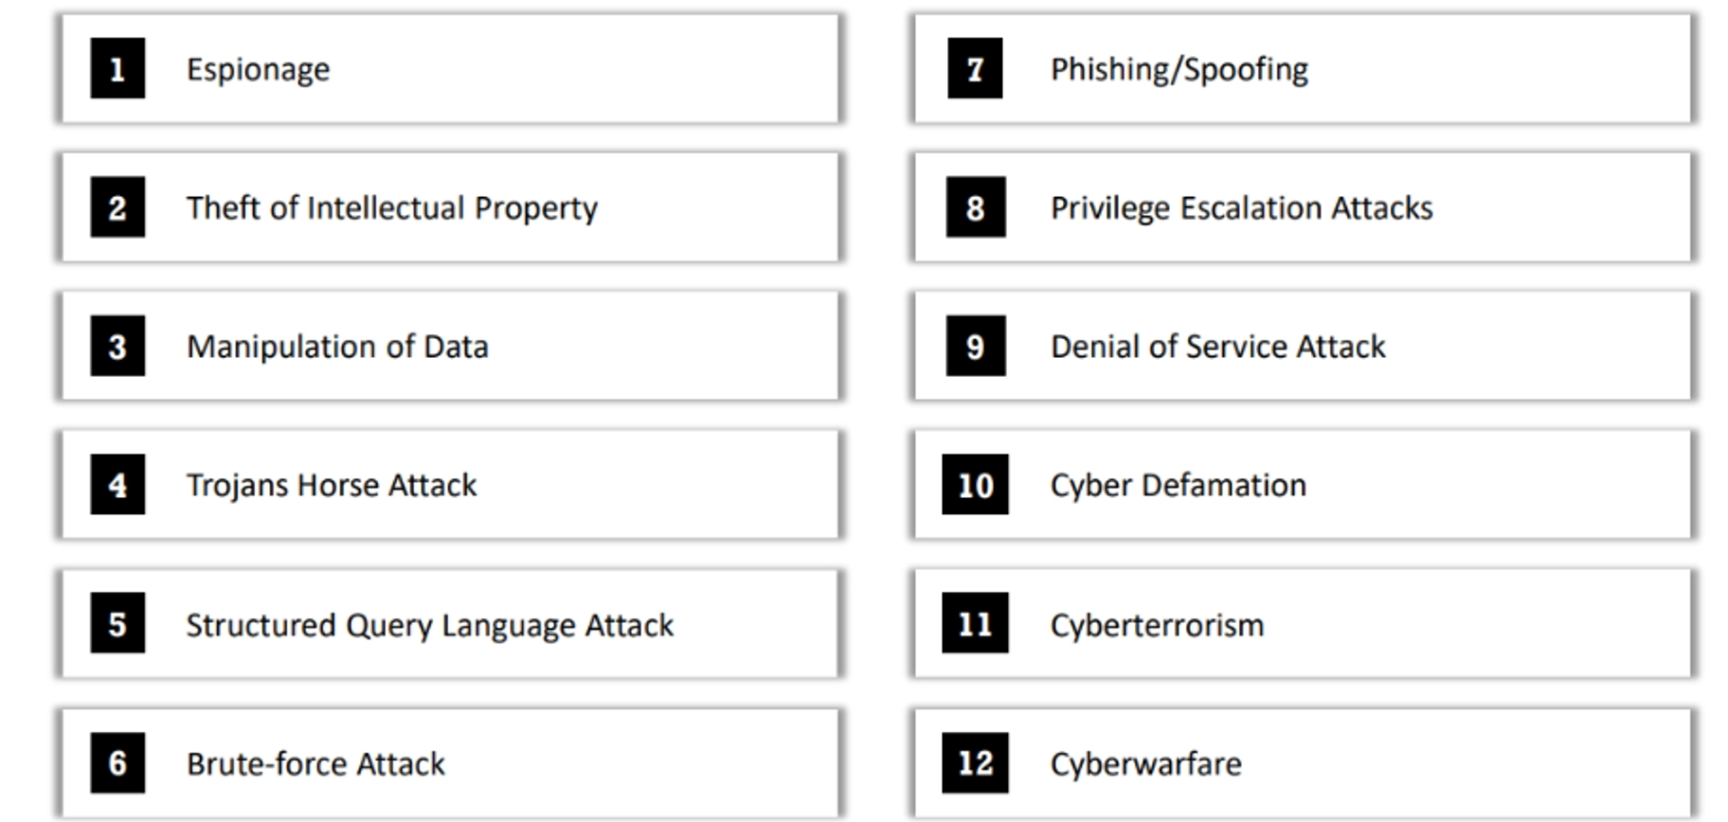
Example of Cyber Crime

Slide 8
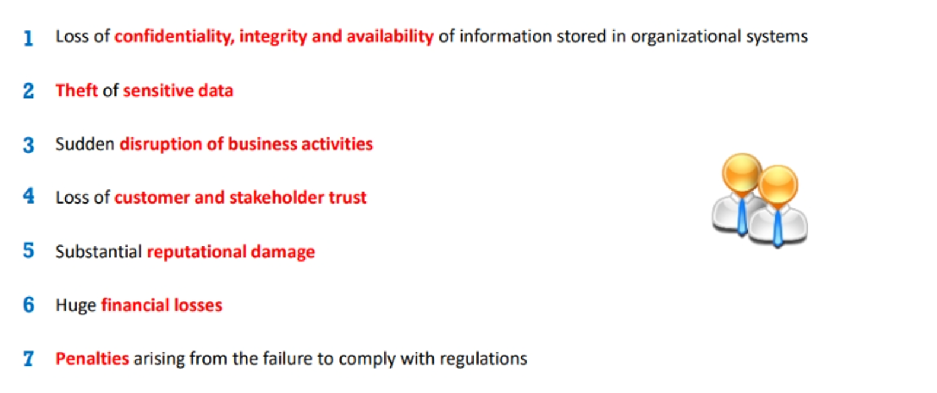
Impact of Cyber Crime at the Organizational Level

Slide 9
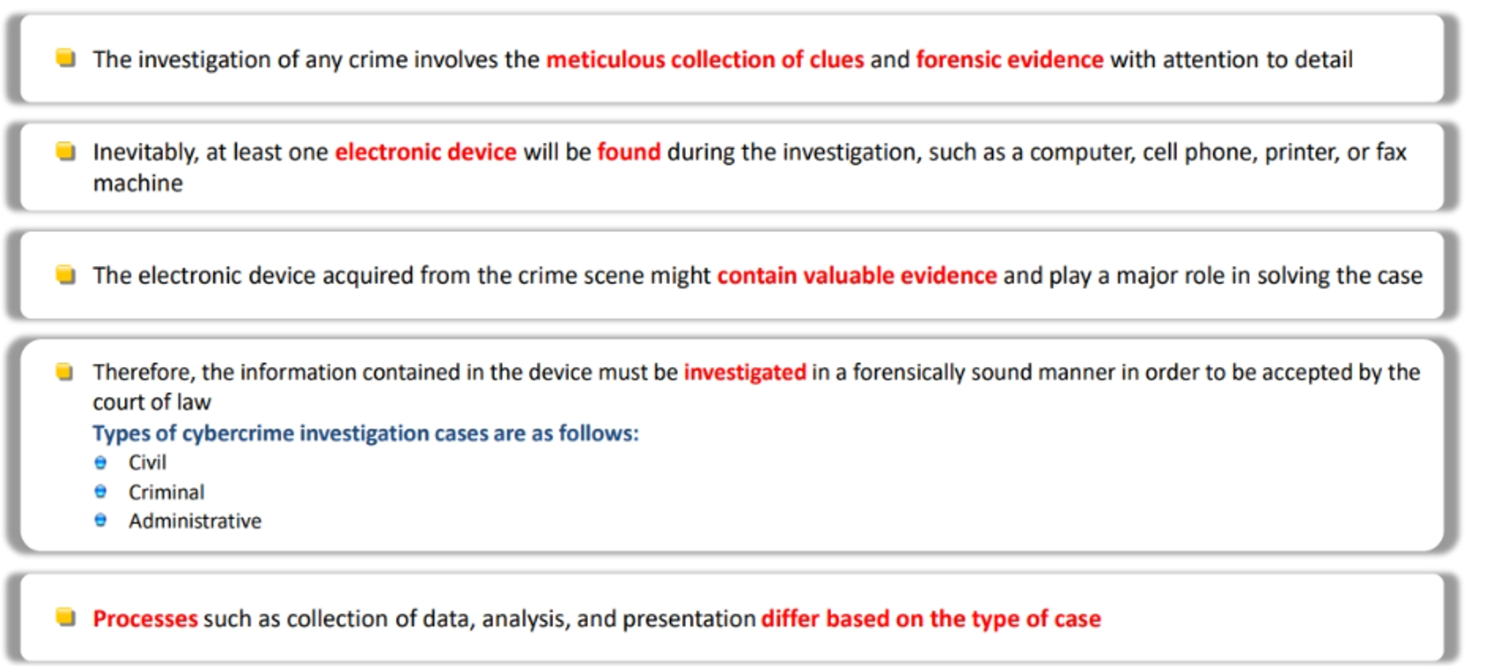
Cyber Crime Investigation

Slide 10
Civil vs. Criminal Investigation
In digital forensics, investigations can generally be categorized into two major types: civil investigations and criminal (or digital) investigations.
Civil Investigation:
A civil investigation in digital forensics deals with disputes between individuals, organizations, or entities, usually involving private rights.
These cases do not involve criminal charges, but rather involve lawsuits or civil litigation.
Purpose: To collect, analyze, and present digital evidence in non-criminal legal matters, such as:
Breach of contract
Intellectual property theft
Employment disputes (e.g., harassment or wrongful termination)
Data breaches affecting business reputation or customer rights
Family law cases (e.g., divorce, custody disputes involving digital evidence)
Example: A company suspects a former employee of leaking confidential data to a competitor. A civil digital investigation may be launched to recover deleted files or trace email communications.
Handled by: Usually conducted by private digital forensic investigators or corporate forensic teams, and used in civil courts.

Slide 11
Digital (Criminal) Investigation in Digital Forensics:
A digital investigation (often referring to criminal digital investigation) involves examining digital devices to uncover evidence of criminal activity.
These are usually conducted by law enforcement or government agencies.
Purpose:
To identify, preserve, analyze, and present digital evidence to prove or disprove a crime, such as: Hacking and cyberattacks, Identity theft or fraud, Online harassment or stalking, Child exploitation or trafficking Terrorism or national security breaches.
Example:
A hacker breaks into a government system. A digital forensic team investigates the compromised systems, identifies IP traces, and collects evidence for court prosecution.
Handled by: Law enforcement agencies (e.g., police cybercrime units), national security agencies, and government-certified forensic labs.

Slide 12
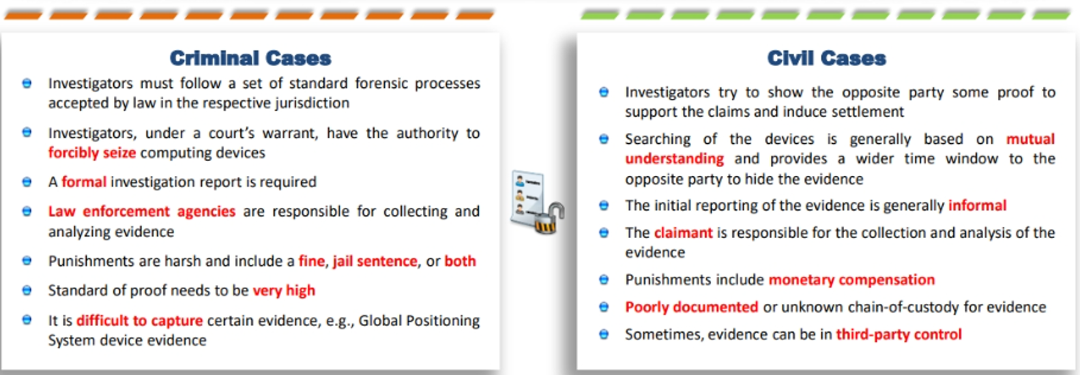

Slide 13
Administrative Investigation
In the cyber world, an administrative investigation refers to a non-criminal inquiry—often internal to an organization—focused on identifying policy violations, misconduct, or misuse of digital systems by employees or affiliates.
Purpose of Administrative Investigations:
- To enforce internal policies (e.g., acceptable use of IT resources)
- To investigate suspicious behavior like data leaks, harassment, or unauthorized access
- To support HR of compliance actions such as disciplinary measures or termination
Common Cyber-Related Scenarios
- Employee data theft or unauthorized file transfers
- Viewing or sharing inappropriate content on company systems
- Bypassing security protocols or installing unauthorized software
- Misuse of email or communication tools for harassment or fraud

Slide 14
Key Characteristics
- Often conducted by internal IT, HR, or compliance teams
- May involve digital forensics (e.g., log analysis, device imaging)
- Can lead to disciplinary action, but not necessarily legal prosecution
- Must balance evidence collection with employee privacy rights

Slide 15

UNDERSTANDING DIGITAL EVIDENCE

Slide 16
Introduction
Digital Evidence refers to any data or information stored or transmitted in digital form that can be used in a court of law to support or refute a legal argument, whether in civil, criminal, or administrative cases.
Examples of Digital Evidence:
Emails and attachments
Text messages, call logs, and chat transcripts (e.g., WhatsApp, Messenger)
Social media posts and profiles
Images, videos, and audio recordings
Browsing history and cookies
Documents (PDFs, Word files, spreadsheets)
IP addresses and geolocation data
System logs and event logs
Network traffic captures
Metadata (timestamps, authorship, etc.)

Slide 17
Sources of Digital Evidence
Computers and laptops
Mobile phones and tablets
Cloud storage (e.g., Google Drive, OneDrive)
Servers and databases
USB drives and external hard disks
IoT devices (smart cameras, smartwatches)
Email servers and web hosting platforms

Slide 18
Why Digital Evidence is important
Authentication: Proves identity or activity (e.g., who sent an email).
Timeline: Establishes when something happened (timestamps).
Corroboration: Supports or contradicts witness testimony.
Linking suspects: Connects people to devices, files, or events.
Reconstruction: Helps understand how a crime or event occurred.

Slide 19
Key characteristics of Digital Evidence
Characteristic | Description
Volatile/non-volatile | Can be easily altered or lost (especially in RAM)/permanent data.
Easily duplicated | Can be copied identically using forensic tools.
Requires authentication | Must prove that it hasn’t been tampered with.
Chain of custody is critical | Must be tracked from collection to court to be admissible.

Slide 20
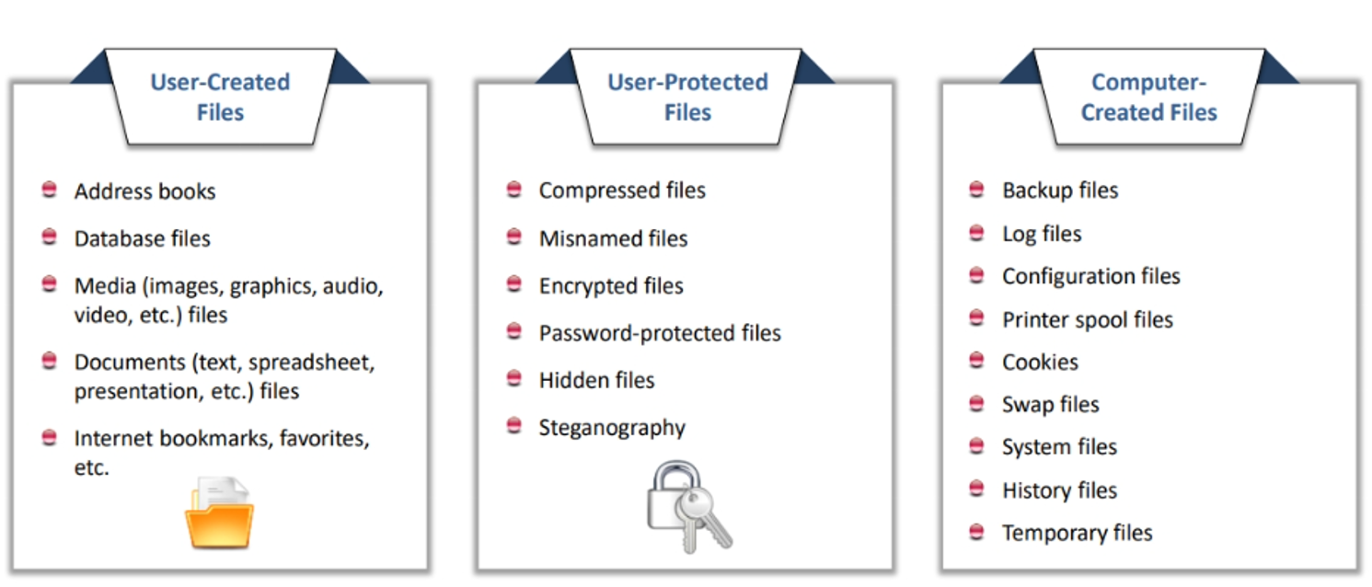
Sources of Potential Evidence

Slide 21
Sources of Potential Evidence(Cont..)
SOURCE TYPE | EXAMPLE
Computers & Laptops | Documents, emails, browsing history, deleted files
Mobile Devices | Texts, call logs, GPS data, app usage, photos, social media
Cloud Services | Files stored on Google Drive, Dropbox, iCloud, backups
Removable Media | USB drives, SD cards, external hard drives
Email Systems | Communication records, attachments, headers
Social Media | Posts, messages, images, metadata (timestamps, geolocation)
Web Browsers | Search history, cookies, cached data
Network Logs | IP addresses, access times, data transfers
Server Logs | User activity, login attempts, system errors
Surveillance Systems | CCTV footage, timestamps, motion detection logs
Gaming Consoles | Chat logs, user activity, online interactions

Slide 22
Less obvious but valuable sources
Instant Messaging Apps (e.g., WhatsApp, Signal):
Encrypted chats, media files
GPS & Navigation Systems:
Location history, travel routes
Vehicle Infotainment Systems:
Paired devices, call logs, navigation data
Digital Cameras:
EXIF metadata in photos (e.g., time, location)
Virtual Machines & Containers:
Snapshots, logs, isolated environments
Online Services:
Forums, cloud-hosted databases, SaaS platforms

Slide 23
Why to collect information from different souces
Each source offers a different lens into user behavior, intent, and timeline. For example:
- A deleted file on a USB drive might be recovered to prove IP theft.
- Chat logs from a gaming console could reveal grooming or harassment.
- Cloud backups might contain incriminating documents long after deletion from a local device.

Slide 24
Rules of Evidence
Digital evidence collection must be governed by five basic rules that makes it admissible in court.
Understandable: Evidence must be clear and understandable to the judge
Admissible: Evidence must be related to the fact being proved.
Authentic: Evidence must be real and appropriately related to the incident.
Reliable: There must not be any doubt about the authenticity of the evidence.
Complete: The evidence must prove the attacker’s actions or his/her innocence.

Slide 25
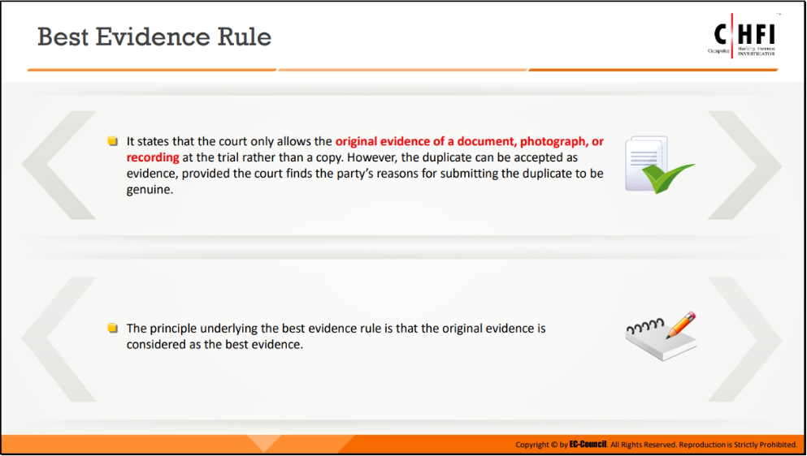

Slide 26
Scientific Working Group on Digital Evidence
SWGDE is a U.S.-based organization that brings together experts from law enforcement, academia, private industry, and government to develop guidelines, standards, and best practices for handling digital and multimedia evidence.
Core Objectives
Promote consistency and quality in digital forensic practices
Foster communication and cooperation across forensic disciplines
Develop consensus-based documents to guide practitioners
Support the creation of national and international standards (e.g., ASTM E2763 for computer forensics)

Slide 27
Membership & Structure
Composed of up to 125 subject-matter experts
Includes forensic scientists, legal professionals, academics, and statisticians
Organized into standing committees (e.g., Audio, Imaging, Quality, Video)

Slide 28
SWGDE Standard and Criteria 1.1
"All agencies that seize and/or examine digital evidence must maintain an appropriate Standard Operating Procedure (SOP) document."
This SOP must:
Clearly outline all policies and procedures related to digital evidence.
Be issued under the agency’s management authority.
Serve as a foundational document to ensure consistency, reliability, and legal defensibility in forensic practices.
Why it matters:
In digital forensics, even small procedural missteps can lead to evidence being challenged or excluded in court.
SOPs help ensure that evidence is handled in a scientifically sound and legally admissible manner.

Slide 29
SWGDE Standard and Criteria 1.2
"Agency management must review the SOPs on an annual basis to ensure their continued suitability and effectiveness.“
Why it matters:
Digital forensics evolves rapidly—new devices, file systems, and threats emerge constantly. This standard ensures that:
Procedures stay current with technological advancements
Personnel remain aligned with best practices
Evidence handling remains legally defensible

Slide 30
SWGDE Standard and Criteria 1.3
"Procedures used must be generally accepted in the field or supported by data gathered and recorded in a scientific manner.”
Why it matters:
This standard ensures that digital forensic methods are:
Scientifically valid: Techniques must be backed by empirical data or peer-reviewed research.
Legally defensible: Courts require that evidence be collected and analyzed using recognized, reliable methods.
Flexible yet rigorous: While multiple valid approaches may exist, each must demonstrate accuracy and reliability.

Slide 31
SWGDE Standard and Criteria 1.4
"All elements of the SOP must be documented and must be available for review.”
Why it matters:
This standard ensures that:
Transparency is maintained—anyone reviewing the agency’s practices (e.g., auditors, courts, or oversight bodies) can access the full scope of procedures.
Accountability is upheld—investigators and analysts follow clearly defined, reviewable protocols.
Consistency is enforced—documented SOPs reduce ambiguity and variation in how digital evidence is handled.
It’s a foundational principle in quality assurance and legal defensibility, especially in environments where digital evidence can make or break a case.

Slide 32
SWGDE Standard and Criteria 1.5
"Agency management must ensure that all documentation is reviewed and approved by management prior to implementation.“
Why it matters:
This standard reinforces the importance of oversight and accountability in digital forensic procedures. It ensures that:
Policies and procedures are vetted before being put into practice
There’s a clear chain of responsibility for what gets implemented
Agencies avoid the risks of unapproved or inconsistent practices

Slide 33
SWGDE Standard and Criteria 1.6
"All activity relating to the seizure, storage, examination, or transfer of digital evidence must be recorded in writing and be available for review and testimony.”
Why it matters:
This criterion emphasizes transparency, accountability, and reproducibility in digital forensic work. It ensures that:
Every action taken with digital evidence is documented in detail
The documentation is accessible for internal review, audits, or courtroom testimony
Another qualified examiner could replicate the process and reach the same conclusions

Slide 34
SWGDE Standard and Criteria 1.6
"Any action that has the potential to alter, damage, or destroy any aspect of original evidence must be performed by qualified persons in a forensically sound manner.“
Why this standard is crucial:
This criterion emphasizes the integrity and reliability of digital evidence. It ensures that:
Only trained professionals handle sensitive operations like imaging, recovery, or analysis.
All actions are conducted using validated tools and techniques that preserve the original data.
The process is defensible in court, minimizing the risk of evidence being excluded due to mishandling.

Slide 35
